Slide 1
The Data Warehouse Toolkit
Second Edition
The Complete Guide To Dimensional Modeling
By Ralph Kimball-Margy Ross
Chapter 4: Procurement

Slide 2
4.0 Overview
Chapter 4 discusses the following concepts:
  Value chain reinforcement
  Blended versus separate transaction schemas
  Slowly changing dimension techniques, both basic and advanced

Slide 3
4.1 Procurement Case Study
The following list gives you a better sense of a procurement organization’s common analytic requirements:
  Which materials or products are purchased most frequently? How many vendors supply these products? At what prices? In what units of measure (such as bulk or drum)?
  Looking at demand across the enterprise (rather than at a single physical location), are there opportunities to negotiate favorable pricing by consolidating suppliers, single sourcing, or making guaranteed buys?
  Are our employees purchasing from the preferred vendors or skirting the negotiated vendor agreements (maverick spending)?
  Are we receiving the negotiated pricing from our vendors (vendor contract purchase price variance)?
  How are our vendors performing? What is the vendor’s fill rate? On-time delivery performance? Late deliveries outstanding? Percent of orders backordered? Rejection rate based on receipt inspection?

Slide 4
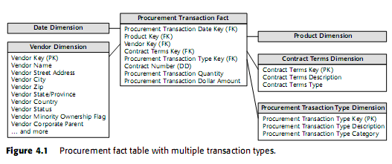
4.2 Procurement Transactions

Slide 5
4.2.1 Multiple- versus Single-Transaction
Fact Tables
We are faced with a design decision
  Build a blended transaction fact table with a transaction type dimension to view all our procurement transactions together
  Build separate fact tables for each transaction type

Slide 6
4.2.1 Con’t
The following considerations to help us sort things out:
First, what are the users’ analytic requirements? As designers, our goal is to reduce complexity in order to present the data in the most effective form for the business users. How will the business users most commonly analyze this data? Do the required analyses often require multiple transaction types together, leading us to consider a single blended fact table? Or do they more frequently look solely at a single transaction type in an analysis, causing us to favor separate fact tables for each type of transaction?
Are there really multiple unique business processes? In our procurement example, it seems that buying products (purchase orders) is distinctly different from receiving products (receipts). The existence of separate control numbers for each step in the process is a clue that we are dealing with separate processes. Given this situation, we would lean toward separate fact tables. In Chapter 3ís inventory example, all the varied inventory transactions clearly related to a single inventory process, resulting in a single fact table design.

Slide 7
4.2.1 Con’t
Are multiple source systems involved? In our example, we’re dealing with three separate source systems: purchasing, warehousing, and accounts payable. Again, this would suggest separate fact tables. The data staging activities required to source the single-transaction fact table from three separate source systems is likely daunting.
What is the dimensionality of the facts? In our procurement example we discovered several dimensions that applied to some transaction types but not to others. This would again lead us to separate fact tables.

Slide 8
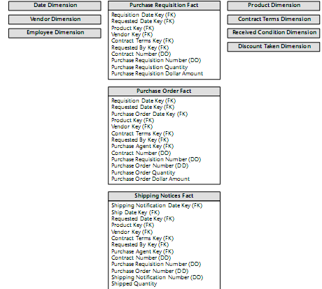
4.2.2 Complementary Procurement Snapshot

Slide 9
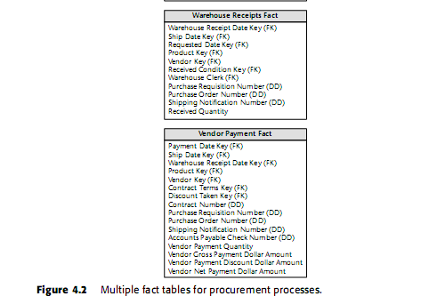

Slide 10
4.3 Slowly Changing Dimensions
Type 1: Overwrite the Value
Type 2: Add a Dimension Row
Type 3: Add a Dimension Column

Slide 11
4.3.1 Type 1: Overwrite the Value
Overwrite the old attribute value in the dimension row, replacing it with the current value.
The type 1 response is easy to implement, but it does not maintain any history of prior attribute values.

Slide 12


4.3.1 Con’t

Slide 13
4.3.2 Type 2: Add a Dimension Row
Supporting the primary goals of the data
warehouse is to represent prior history correctly.
The type 2 response is the primary technique for accurately tracking slowly changing dimension attributes. It is extremely powerful because the new dimension row auto­matically partitions history in the fact table.

Slide 14

4.3.2 Con’t

Slide 15

4.3.3 Type 3: Add a Dimension Column
Track history in terms of the new district names and conversely to track new data in terms of old district names.
The type 3 slowly changing dimension technique allows us to see new and historical fact data by either the new or prior attribute values.

Slide 16
4.4 Hybrid Slowly Changing Dimension Techniques
Combine basic slowly changing dimension techniques

Slide 17
4.4.1 Predictable Changes with
Multiple Version Overlays
Business users have a more complex set of requirements, including the following capabilities:
  Report each year’s sales using the district map for that year.
  Report each year’s sales using a district map from an arbitrary different year.
  Report an arbitrary span of years’ sales using a single district map from any chosen year. The most common version of this requirement would be to report the complete span of fact data using the current district map.

Slide 18
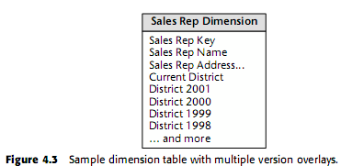
4.4.1 Con’t

Slide 19
4.4.2 Unpredictable Changes with
Single-Version Overlay
Preserve historical accuracy surrounding unpredictable attribute changes while supporting the ability to report historical data according to the current values.

Slide 20


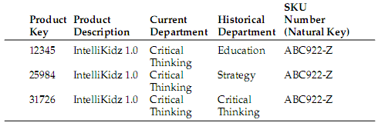
4.4.2 Con’t

Slide 21
4.5 More Rapidly Changing Dimensions
Break off these rapidly changing attributes into one or more separate dimensions.

Slide 22
4.6 Summary
Discussed several approaches to handling procurement data.
Introduced several techniques to deal with changes to our dimension table attributes.

